Slide 1
Anti-Discrimination Working Group
Kick-off meeting
Friday 31st March 2022
9.30am, NCRR main meeting room (and online)

Slide 2

Agenda
Introduction round
Aims of the group
Jed’s Twitter thread
Communication paradigms: a case study (Rosenberg et al., 2002)
Discussion
Ideas for next meeting

Slide 3
Aims of the group
To strive for equality
To strive for diversity
To be open & transparent
To be mindful that the topics we discuss may be triggering and upsetting, impacting on people in different ways.
This is not a passive intellectual topic. It takes time to install the correct support and find solutions. This is a learning process.
To discuss ongoing issues with discrimination in research
To recognize harmful structures and practices of discrimination in research
To advocate for changes that promote equity in research

Slide 4
Jed's Twitter thread
Problem | Action
1) Existence of extremist "journal clubs" | Familiarize yourself with how papers are appropriated Conduct your research conscientiously assuming there's a chance it will receive a stamp of approval from a hateful terrorist
2) "Meme-ification" of figures (particularly PCA plots) | Understand how our communication can be (mis)interpreted Improve established visualisation paradigms
3) Interest in research on the genetics of cognitive/behavioural traits (particularly IQ) | Be the "loudest voice in the room" discussing your own research Defend your work, particularly against those with a warped appreciation (e.g., intervene, respond with factual information, address the faulty rhetoric)

Slide 5
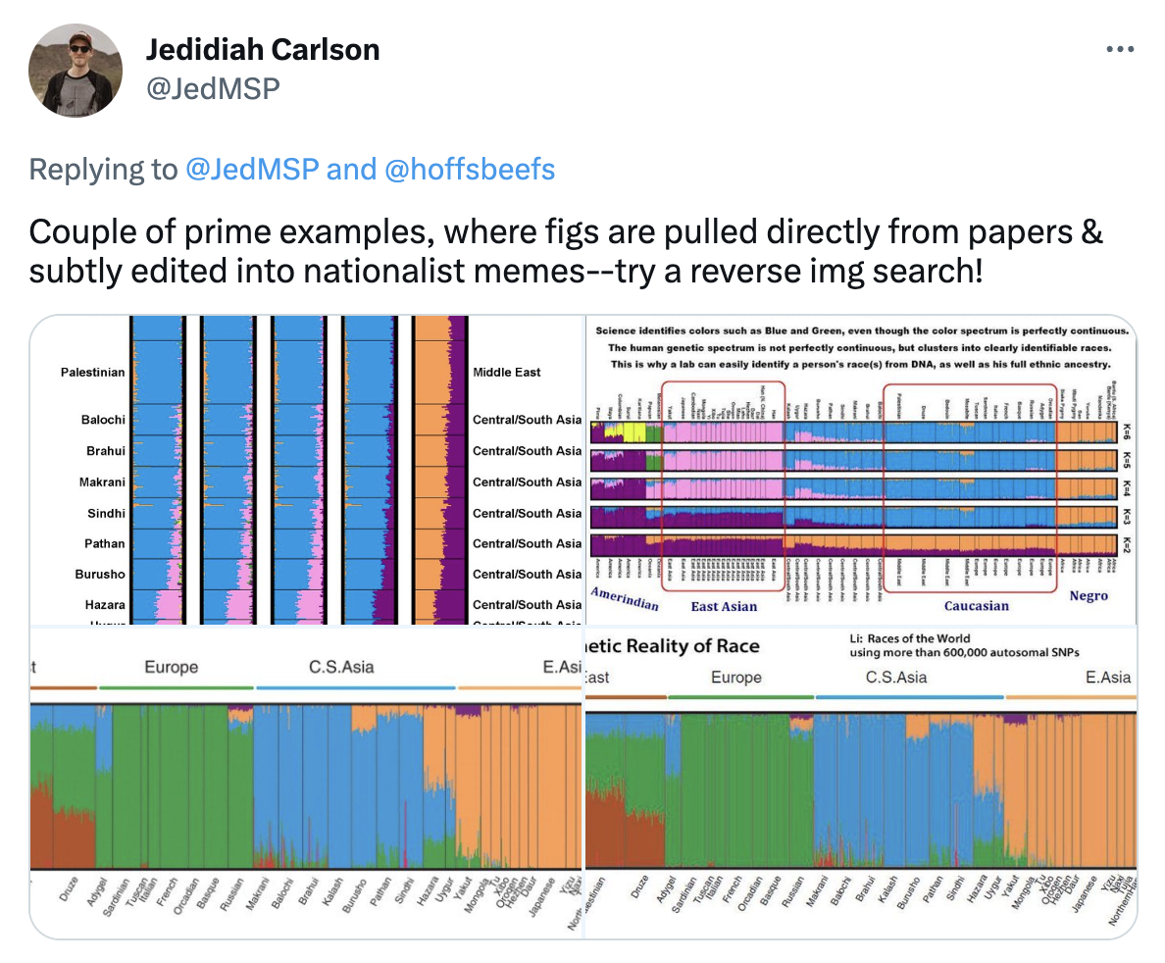
Communication paradigms

Slide 6
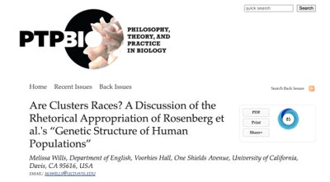
Case study: Rosenberg et al., (2002)

Slide 7
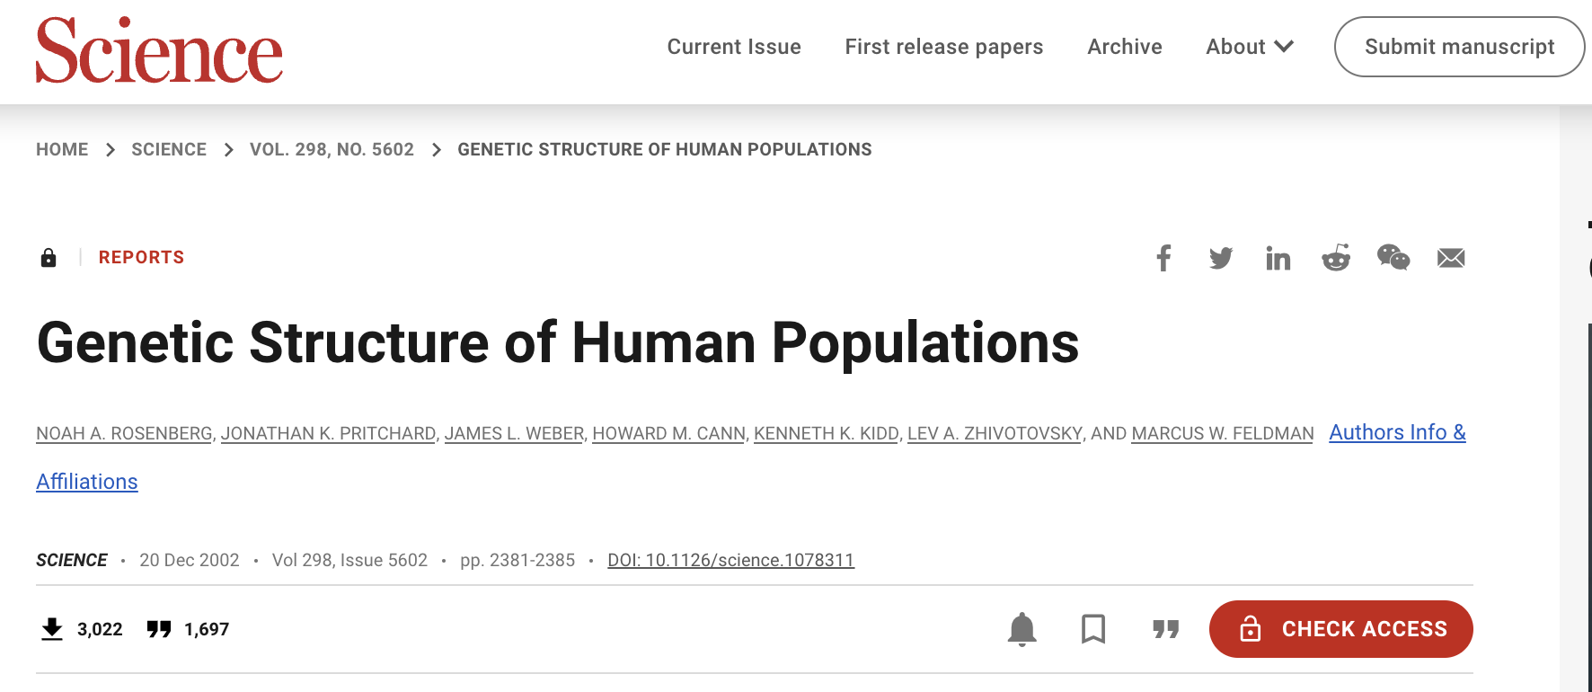
Case study: Rosenberg et al., (2002)
"Genetic Structure of Human Populations" (published in Science)
Most cited paper in Science in its year of publication
Continues to be cited in scientific and philosophical debates 20 years on

Slide 8
Case study: Rosenberg et al., (2002)
What did they do?
Clustering algorithm structure
Human Genome Diversity Cell Line Panel
N = 1,056 individuals from 52 distinct global populations
377 microsatellite DNA

Slide 9
Case study: Rosenberg et al., (2002)
Abstract
"We studied human population structure using genotypes at 377 autosomal microsatellite loci in 1056 individuals from 52 populations. Within-population differences among individuals account for 93 to 95% of genetic variation; differences among major groups constitute only 3 to 5%. Nevertheless, without using prior information about the origins of individuals, we identified six main genetic clusters, five of which correspond to major geographic regions, and subclusters that often correspond to individual populations. General agreement of genetic and predefined populations suggests that self-reported ancestry can facilitate assessments of epidemiological risks but does not obviate the need to use genetic information in genetic association studies."

Slide 10
Case study: Rosenberg et al., (2002)
What did they conclude?
Membership coefficient patterns tended to be consistent across individuals with predefined populations
“...genetic clusters often corresponded closely to predefined regional or population groups or to collections of geographically and linguistically similar populations”
Inferred clusters tended to agree with geography (regional and worldwide)
Genetic drift, geographical or linguistic isolation largely drive genetic differences between groups

Slide 11
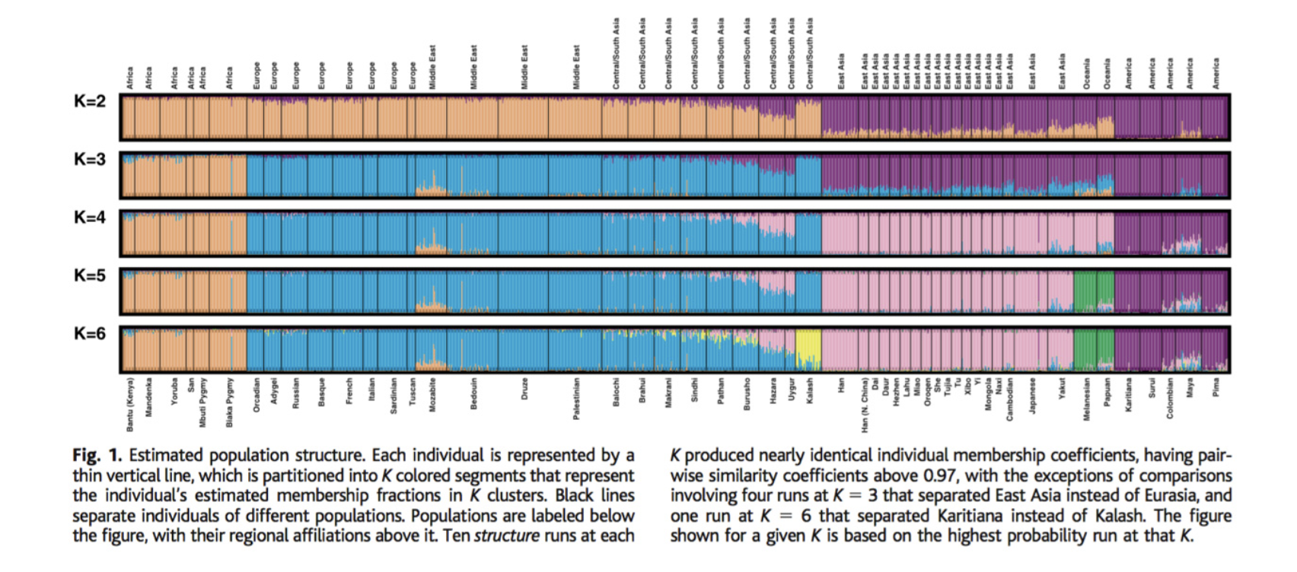
Case study: Rosenberg et al., (2002)

Slide 12
Case study: Rosenberg et al., (2002)
K is variable, but they emphasise K=6
E.g., in abstract “we identified six main genetic clusters, five of which correspond to major geographic regions, and subclusters that often correspond to individual populations”
Nowhere do the authors mention the term "race"
They exclusively refer to "populations" or "clusters"
The end of the article reminds the reader of genetic similarity between individuals across the world
“...because most alleles are widespread, genetic differences among human populations derive mainly from gradations in allele frequencies rather than from distinctive `diagnostic' genotypes. Indeed, it was only in the accumulation of small allele-frequency differences across many loci that population structure was identified.”

Slide 13
Case study: Rosenberg et al., (2002)
Rosenberg et al., (2002) has repeatedly been cited as evidence for a biological basis to race
(This is a claim the authors DO NOT make)
Sesardic (2010) - "an important discovery that makes it much more difficult than before to claim that race is entirely disconnected from genetics”
Wade (2014) - “not only expected traits like skin color and nutritional metabolism but also some aspects of brain function”. Cites Rosenberg et al., (2002), draws complete equivalence between the clusters and racial groupings.
Sesardic (2013) - "scientific validation of the race concept”

Slide 14
Case study: Rosenberg et al., (2002)
Authors have completely rejected these misinterpretations
Many others have criticised Sesardic and Wade
Melissa Wills:
"Critics of this misinterpretation have often suggested that it follows from interpreters' personal biases skewing the reception of an objective piece of scientific writing. I contend, however, that the article itself to some degree facilitates this misrepresentation.”
"While such rebuttals are vital in rejecting the racial interpretation, I challenge this tendency to scrutinize the language and motives of the interpreters without considering their source material."

Slide 15
Case study: Rosenberg et al., (2002)
Discussion time!
Can anyone think of any ways in which the authors could have facilitated this misinterpretation?

Slide 16
Case study: Rosenberg et al., (2002)
Melissa Wills points out:
Emphasis on K=6, 5 of which map onto geographical clusters
Labels above figure
Wording
"Correspond"
"Anchored in"
"Match"

Slide 17
Discussion
What do you think about having to keep these points in mind?
Jed → The link between misappropriation of research and violence should factor into decisions made by IRBs, funders, and journal editors. What do you think about this?
How do you feel about having to "intervene" with the rhetoric on social media?
Any ideas about possible alternatives to visualization paradigms?

Slide 18
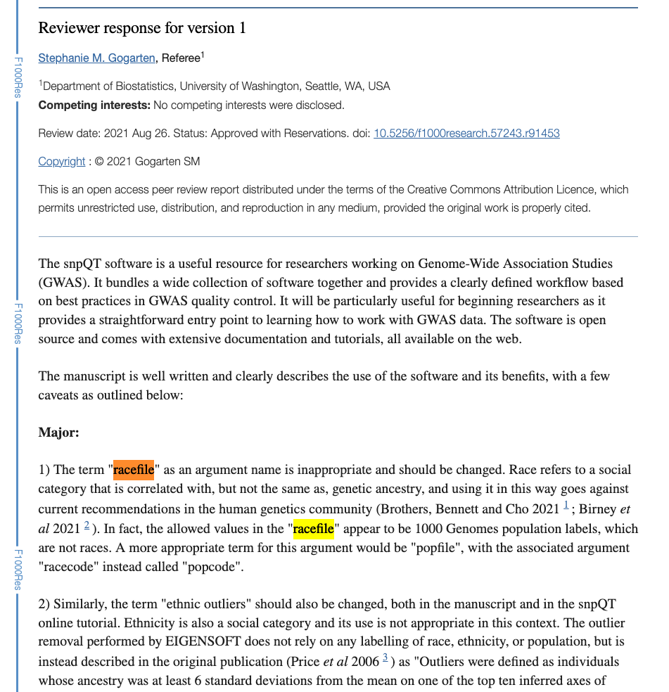
Ideas for next meeting
Historical perspective
E.g., parallel development of genetics and eugenics
Book club
E.g., The Immortal Life of Henrietta Lacks
How-to: Active anti-discrimination
E.g., “racefile” for PC plots in a published bioinformatics tool → here is how one reviewer addressed it:

Slide 19



Thanks!
Next meeting:
Early May
Jess Mundy
Hannah Chatwin
Alisha Hall
jmundy@clin.au.dk
hchatwin.ncrr@au.dk
alishasmhall@clin.au.dk
@jessmndy
@hannahchatwin2
@asmhall

Slide 20
Resources
Science piece on how papers are appropriated
Article on how to be mindful in writing

